Slide 1

SMS Spam Detection Systems
This presentation explores the challenges of SMS spam detection and discusses various approaches to building robust systems.

Slide 2
PROJECT GUIDE : M.SUJANI OUR TEAM MEMBERS:
D UDAYA BHASKAR
K HARSHA VARDHAN
P SOMANADH
P NIKHILESH
G NITHIN BHARGAV

Slide 3
SMS Spam Detection System Using ML
Abstract:
This project uses machine learning and natural language processing to identify and filter spam SMS messages. By analysing text features such as word frequency, patterns, and sender details, the system classifies messages as spam or legitimate. This helps users manage their messages effectively and prevents phishing scams.
Applications:
Preventing phishing and fraudulent messages.
Enhancing mobile user experience.
Automating spam filtering in messaging apps.
Technologies:
NLP libraries (NLTK, TextBlob).
Classification models like Naive Bayes and SVM.

Slide 4
INDEX
Abstract
Brief overview of the project objectives, methodology, and outcomes.
Introduction
Background of the problem or research.
Importance and scope of the project.
Objectives and goals.
Literature Review
Summary of previous research or related work.
Gaps identified in existing methods.
Methodology
Overview of the approach used.
Tools, technologies, and datasets involved.
Implementation
Detailed explanation of the workflow.
Code structure and key algorithms.
Experiments and Results
Description of testing methods.
Observations, metrics, and outcomes.

Slide 5
7.Analysis and Discussion
Inte­­­­­­­rpretation of results.
Challenges encountered.
Comparison with existing methods.
8.Conclusion and Future Work
Summary of findings.
Suggestions for further research or improvement.
9.References
Cited works, tools, and resources used

Slide 6
Introduction to SMS Spam
What is it?
Impact
Unsolicited and unwanted messages sent to mobile devices, often with malicious intent.
Annoying, intrusive, and potentially dangerous, leading to financial losses and privacy breaches.

Slide 7
SCOPE OF PROJECT
Problem Identification:
Understanding the impact of spam on users, organizations, and systems.
Highlighting the need for effective detection and mitigation strategies.
Objectives:
Developing techniques to identify and block spam messages.
Ensuring minimal false positives while maintaining high accuracy.
Implementation Areas:
Email communication, social media, SMS, and other messaging platforms.
Integration with cybersecurity systems for enhanced protection.
Expected Outcomes:
Reduced spam-related security risks and resource wastage.
Improved user experience and system efficiency.

Slide 8




LIFE CYCLE OF SPAM
Creation
Distribution
Engagement
Detection and Adaptation
Spammers create bulk messages with deceptive content or malware, compiling target lists through scraping or data breaches.
Spam is distributed via email, SMS, or botnets, using automation to bypass filters.
Victims engage with malicious content, leading to data theft, financial loss, or system compromise.
Filters detect and block spam, and users report it; spammers adapt to evade detection.

Slide 9

Challenges of SMS Spam Detection
Evolving Spam Tactics
Data Scarcity
Limited access to labeled spam data for training effective models.
Spammers constantly adapt their techniques, making it difficult to stay ahead.
Language Diversity
Spam messages can be written in multiple languages, requiring multilingual models.

Slide 10



SPAM AS A PROBLEM
Resource Drain
Productivity Loss
Security Risks
Spam wastes bandwidth, storage, and processing power, increasing costs.
Constant spam disrupts workflows and reduces productivity.
Spam often carries phishing attacks, malware, and other cyber threats, increasing data breach risks and financial losses.

Slide 11



Baseline Model: Multinomial Naive Bayes
1
Simple and Effective
2
Assumptions
Assumes independence of words in a message.
3
Limitations
May struggle with complex language patterns.

Slide 12



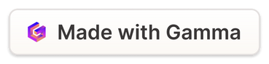
Custom Text Vectorization and Embedding
Vectorization
Embedding
Transforms text into numerical vectors for machine learning.
Creates dense vector representations that capture word relationships.

Slide 13
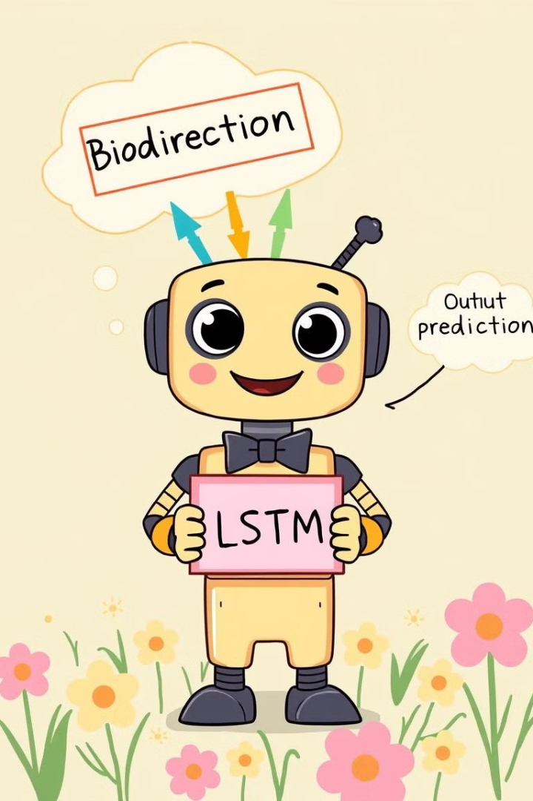


Bidirectional LSTM Model
Recurrent Neural Network
Processes sequential data like text, capturing contextual dependencies.
Bidirectional
Processes text from both directions, improving understanding of context.

Slide 14
Transfer Learning with Universal Sentence Encoder
1
Pre-trained Model
Leverages existing knowledge from large text datasets.
2
Fine-tuning
Adapts the model to the specific SMS spam detection task.
Benefits
3
Improves performance with limited data, reduces training time.

Slide 15
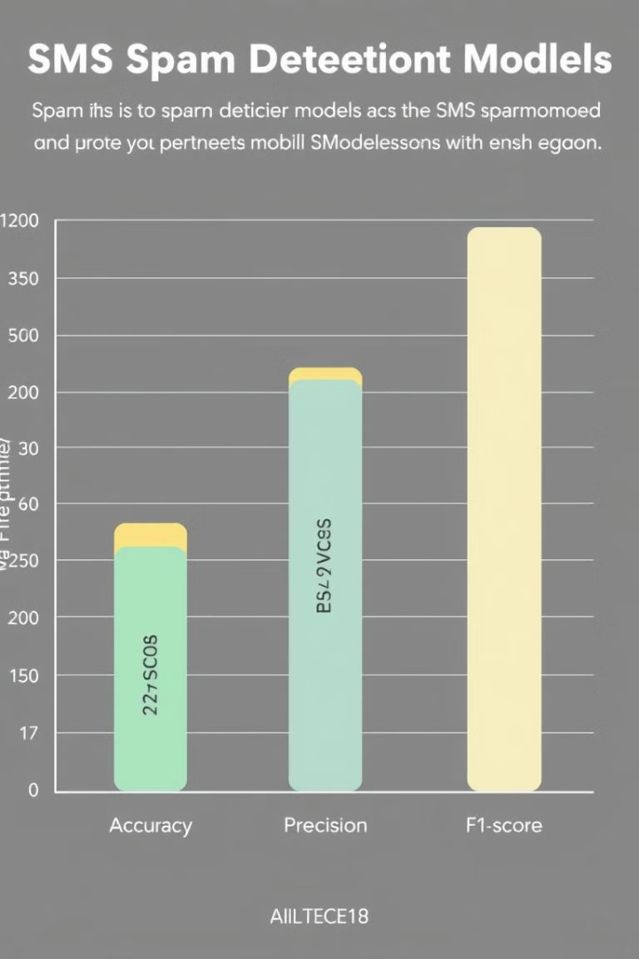
Evaluating Model Performance
95%
98%
Accuracy
Precision
Percentage of correctly classified messages.
Ratio of correctly identified spam messages to all predicted spam messages.
97%
Recall
Ratio of correctly identified spam messages to all actual spam messages.

Slide 16
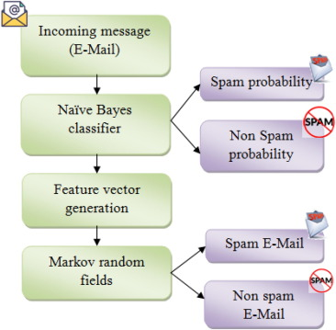
Naive Bayes Classifier for Spam detection

Slide 17
"Advancements in Naïve Bayes for Spam Detection: Key Improvements Over Earlier Versions"
Better Handling of Text Data
Modern Naïve Bayes classifiers (e.g., Multinomial or Bernoulli Naïve Bayes) are optimized for text classification.
Use of TF-IDF (Term Frequency-Inverse Document Frequency) helps improve accuracy.
Improved Probability Estimations
Earlier versions suffered from zero probability issues for unseen words, but Laplace (or additive) smoothing now helps in better estimation
Modern Naïve Bayes models incorporate n-grams and stopword removal to focus on important words in spam detection.
Faster & More Scalable
The latest implementations use efficient matrix operations, making them scalable for large datasets.
Handles Noisy Data Better
Improvements in handling misspelled words, spam variations, and adversarial content make it more robust.

Slide 18

Conclusion and Next Steps
This presentation explored various techniques for SMS spam detection, demonstrating the evolution of systems from simple to more sophisticated. Continued research is needed to stay ahead of evolving spam tactics and enhance system robustness.

Slide 19
THANK YOU

